Slide 1


Slide 2
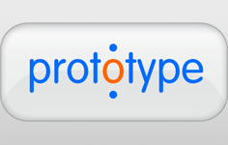





Slide 3
Yet another JS framework?

Slide 4
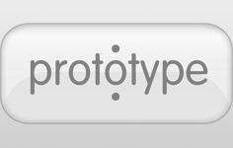




DOM Manipulation

Slide 5
“Other frameworks deal with HTML’s shortcomings by either abstracting away HTML, CSS, and/or JavaScript or by providing an imperative way for manipulating the DOM. Neither of these address the root problem that HTML was not designed for dynamic views.”
https://angularjs.org/

Slide 6


When to use
?
Single Page Applications
S P A
https://www.flickr.com/photos/uniquehotelsgroup/5689788783/in/photostream/

Slide 7

Core Concepts
Client-Side Templates
Model-View-Controler
Data-Binding
Directives
Dependency Injection

Slide 8
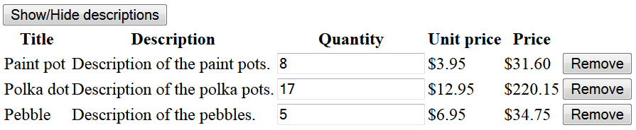
Example
Shopping Cart
\src\examples\AngularJS - Shopping Cart\ShoppingCart.html

Slide 9
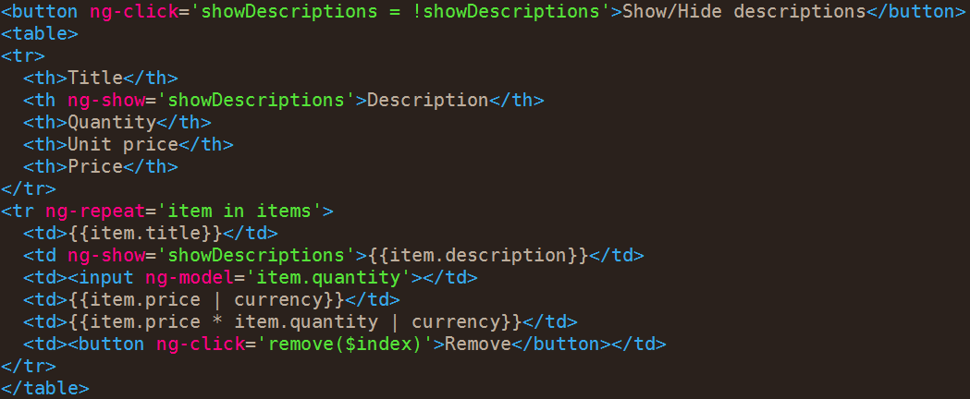
Client-Side Templates

Slide 10
Model-View-Controler

Slide 11
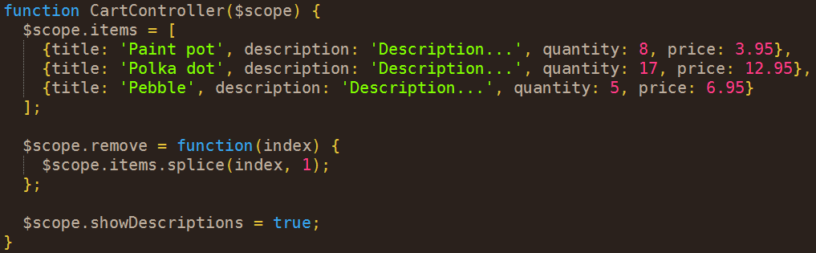
Model-View-Controler

Slide 12
Model-View-Controler
?

Slide 13
$scope
“Scope is the glue between application controller and the view.”
https://docs.angularjs.org/guide/scope

Slide 14
$scope
“Scope has references to the model.
Create your own model object and then you put a reference to the model object from the scope.”
AngularJS MTV Meetup: Best Practices (2012/12/11) (30:08) http://www.youtube.com/watch?v=ZhfUv0spHCY

Slide 15

AngularJS MTV Meetup: Best Practices (2012/12/11) (30:08) http://www.youtube.com/watch?v=ZhfUv0spHCY

Slide 16
Example
Shopping Cart With the Model
\src\examples\AngularJS - Shopping Cart\ShoppingCartWithTheModel.html

Slide 17
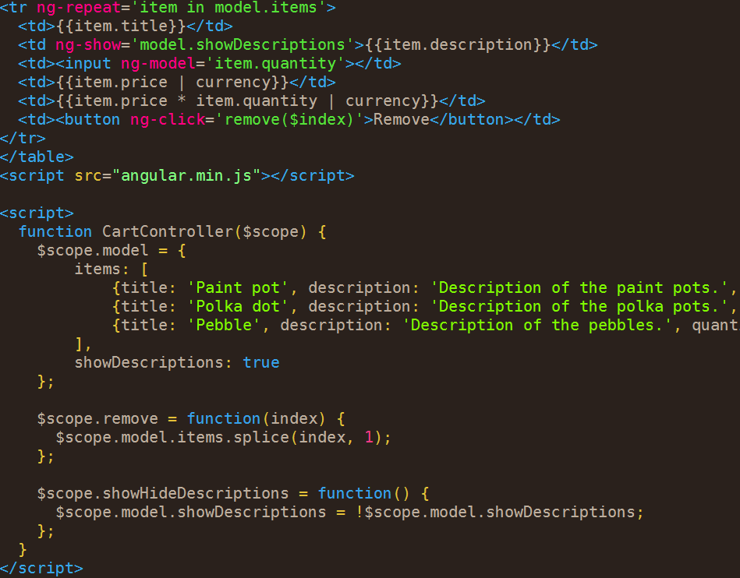
Model-View-Controler

Slide 18
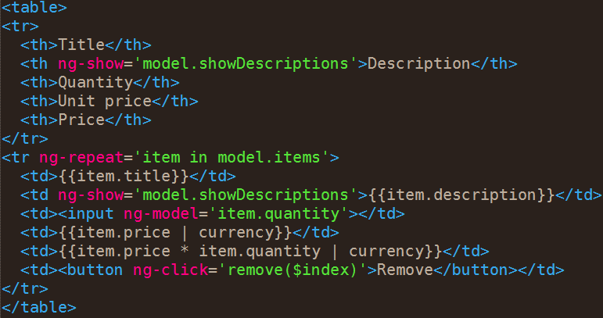
Data-Binding

Slide 19
Directives

Slide 20
Dependency Injection

